Slide 1
ENGAGE final workshop 11-13 September 2019 Bratislava, Slovak Republic PRESENTATION OF MAIN FINDINGS AND DRAFT RECOMMENDATIONS, ILLUSTRATION WITH CASE STUDIES
T3: Alignment of different decision levels: local, regional, national and international
Catrinel Turcanu, SCK•CEN

Slide 2
Recommendations, WHAT is needed WHY is needed HOW can be done
a synthesis of the main Recommendations for Stakeholder engagement, as emerging in ENGAGE Project for each exposure situation
the motivations, WHY, and the approaches, HOW, to proceed towards the Recommendation implementation

Slide 3
T3: Alignment of different decision levels: local, regional, national and international -List of Recommendations
EP&R
MEDICAL
RADON
Develop guidelines that integrate how stakeholders at different governance levels (including international, European) can/should be engaged. A link should be made to national EP&R plans
An active and uniform implementation in practice of patient participation in decision making
The radon action plan should adopt a systemic approach that considers also the governance levels between the national and the local that are responsible for health, environment and energy issues.
Develop context specific approaches for radon measurement and mitigation, at the appropriate governance level(s)

Slide 4
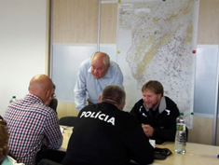
Alignment of different decision levels: local, regional, national and international EP&R
Minimal requirements on stakeholder engagement
Very few prescriptions on how the interaction between the stakeholders of various decision levels should/can be organised.
E.g. in Italy, bilateral agreements for communication, but not clear how to organise this in practice
Alignment of different decision levels (local, national and
international) is challenging and interpreted differently
E.g. in Slovak Republic, no Revised National Emergency Plan,
thus missed opportunity to create a common communication network.
Various levels of stakeholder engagement can be identified from results; these levels are dependent on the context of stakeholder engagement.
Recommendation EP&R 5: Develop guidelines that integrate how stakeholders at different governance levels (including international, European) can/should be engaged. A link should be made to national EP&R plans.

Slide 5
Alignment of different decision levels: local, regional, national and international Medical use of ionising radiation
The approach for stakeholder engagement in decision making in the medical field centred on the involvement of professionals.
E.g. aiming at creating awareness of the justification principle, application of good practices, informing patients of risks/benefits of radiology, quality assurance, optimised procedures, good safety culture
The need to include patients well recognised by professional organisations, but
not implemented in practice
not completely active and uniform, considering the different
regional, national and international levels.
New paradigm in medical healthcare centred on patient's needs, values and preferences requires
Involvement/engagement of patients and families in the judgement of benefits for patients, and for the society, as a whole.
Recommendation Medical 3: An active and uniform implementation in practice of patient participation in decision making is needed
Notes:
Development of high-performance technology, in the field of imaging, can be recognized as a benefit for the patients, but at the same time is leading to a large increase in exposure for the society.

Slide 6
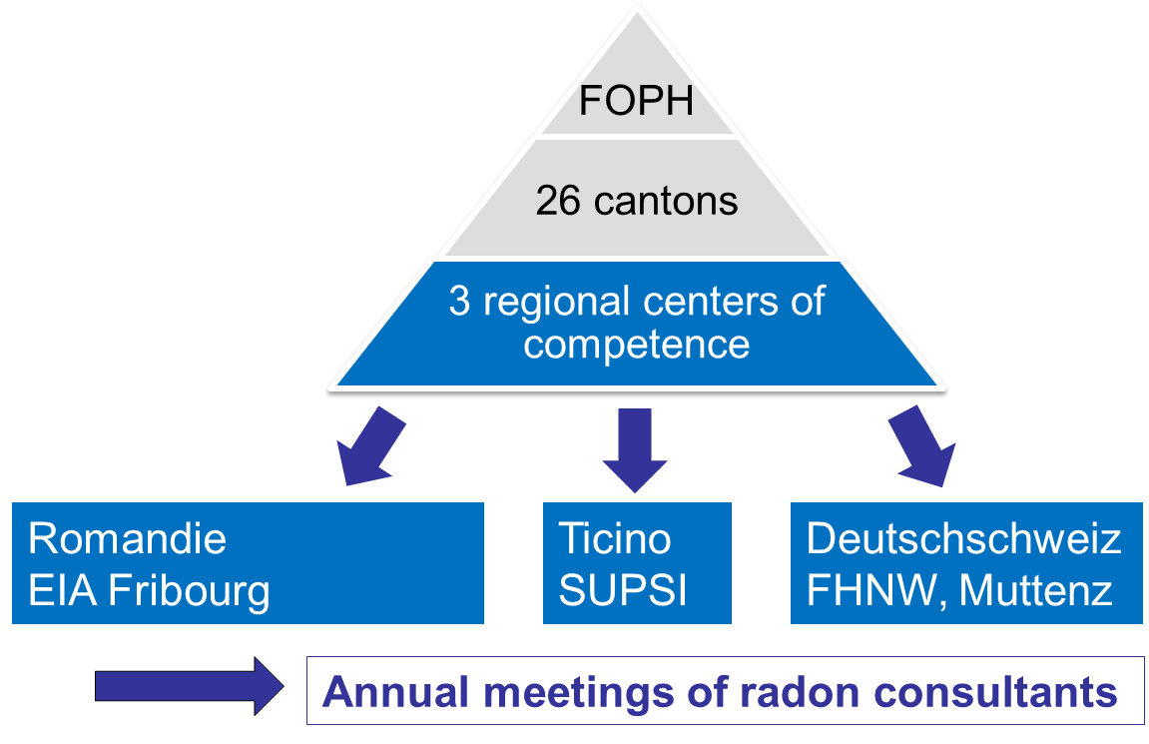
Alignment of different decision levels: local, regional, national and international Radon
Mobilizing political actors around of radon issues challenged by the multiplicity of:
Instances of power which are called upon to coordinate their actions
Different political choices for approaching the radon issue.
Different vertical levels of power involved in radon risk analysis and risk management: the federal, the regions, the provinces and the municipalities.
➔ see e.g. case study in Belgium
Distribution of responsibilities
E.g. for indoor air quality, health prevention, public health protection, product regulation, management of public infrastructures
The importance of the intermediate, regional level, is underestimated
In some countries good practices can be identified.
➔ case study Switzerland
Recommendation Radon 6: The radon action plan should adopt a systemic approach that considers also the governance levels between the national and the local that are responsible for health, environment and energy issues.
Notes:
At regional level there are political choices to be made (cost of remediation, value of estate) and the question is who pays for the related costs? (e.g. for mitigation measures, or the lower value of the estate).

Slide 7
Alignment of different decision levels: local, regional, national and international Radon
Radon measurements and research take place at the national level, but mitigation occurs at local level, and is very context-specific.
Risk communication not always consistent or taking place at the adequate level of governance.
Need to articulate risk assessment with risk management
National campaigns may be less effective than campaigns at
the local level.
Top down approach not effective for private houses, but works (better)
for public buildings.
➔ see e.g. case studies in France, Italy
Challenge for stakeholder engagement:
dealing with contrasting emotions in the local populations: from fear or panic, up to disinterest in taking actions because of, among others, expenses of mitigating actions.
Recommendation Radon 7: Develop context specific approaches for radon measurement and mitigation, at the appropriate governance level(s)
Notes:
At regional level there are political choices to be made (cost of remediation, value of estate) and the question is who pays for the related costs? (e.g. for mitigation measures, or the lower value of the estate).

Slide 8
Round table on HOW recommendations can be put into practice

