Slide 1
ENGAGE final workshop 11-13 September 2019 Bratislava, Slovak Republic OVERVIEW OF CONTEXT, WORKING METHODOLOGY, STUDIES, FINDINGS
Exposure to indoor radon
Christiane Pölzl-Viol, BfS
Catrinel Turcanu, SCK-CEN
Caroline Schieber, CEPN

Slide 2
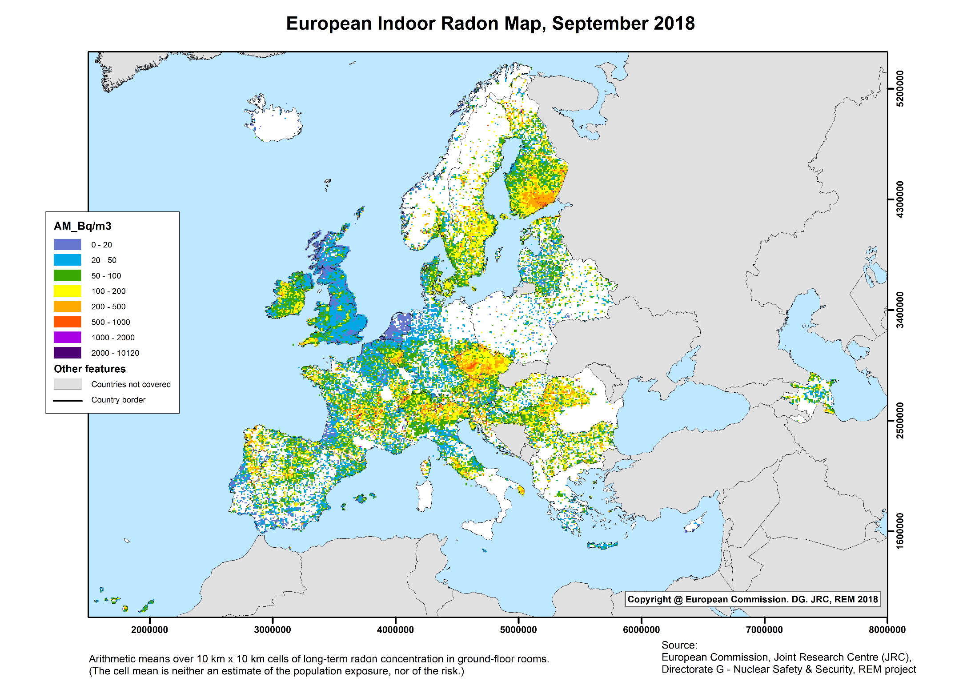

Slide 3
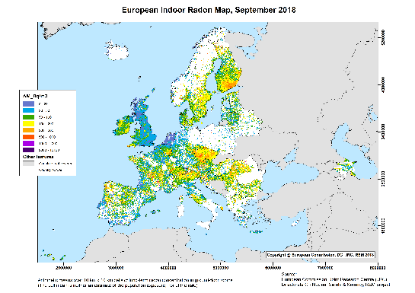
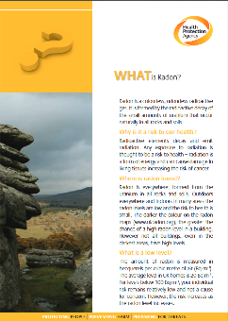
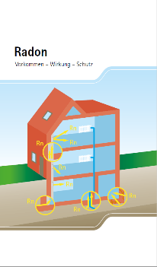
Context
Actions to reduce the radon should be considered at many EU Member States
Last decade: different communication campaigns in EU member states
But: Most of the campaigns were based on a one way information: brochures and documents

Slide 4
Context
In some countries:
Although people living in high radon areas know that radon is bad for their health, they are not concerned about living in a house with high radon concentrations.
Campaigns aimed at increasing radon awareness showed:
increased awareness does not automatically lead to action and behavioural change.
Radon measurements: → Only small fractions of the population in affected areas carry out effectively.
National campaigns proved less effective than campaigns at local level. → Local initiatives for radon risk reduction are currently being developed, with support from national authorities.

Slide 5
Why Stakeholder engagement?
Negotiation with involved parties has taken place in the past on different levels
local municipalities, building industry
involving main players in new legislation
Training of architects, local governments
But: no structured approach to stakeholder engagement
Awareness does not automatically lead to action – stakeholder engagement may contribute to addressing this value-action gap

Slide 6
Why Stakeholder engagement? A (legal) request for engagement
“National action plans are needed for addressing long- term risks from radon exposure”
Annex XVIII, 10: “Strategy for communication to increase public awareness and inform local decision makers, employers and employees of the risks of radon, including in relation to smoking“.
§102 „Member States shall provide as appropriate for the involvement of stakeholders in decisions regarding the development and implementation of strategies for managing exposure situations “

Slide 7
ENGAGE WP 1: Rationales and frameworks for stakeholder engagement in radiation protection
Document analysis
International documents
National prescriptions
Interviews with representatives of international organisations

Slide 8
International documents
WHO Handbook on indoor radon. A public health perspective. 2009
RADPAR Project. RADPAR FINAL SCIENTIFIC REPORT Radon Prevention and Remediation (2012)
EU Drinking water directive 2013/51/EURATOM with regard to radioactive substances in water intended for human consumption.
EU Basic Safety Standards 2013
ICRP Publication 126. Radiological Protection against Radon Exposure. ICRP 2014
IAEA Specific safety guide 2015 Protection of the Public against Exposure Indoors due to Radon and Other Natural Sources of Radiation.
IAEA: Radon in Homes. Factsheet for Decision Makers.
HERCA 2016 Common understanding and recommendations related of the BSS requirements on radon in workplaces.
→ “persuade, inform”
→ “inform”
→ “inform”

Slide 9
International documents: a closer look at…
WHO Handbook on indoor radon. A public health perspective. 2009
EU Basic Safety Standards 2013
ICRP Publication 126. Radiological Protection against Radon Exposure. ICRP 2014
IAEA Specific safety guide 2015 Protection of the Public against Exposure Indoors due to Radon and Other Natural Sources of Radiation.

Slide 10
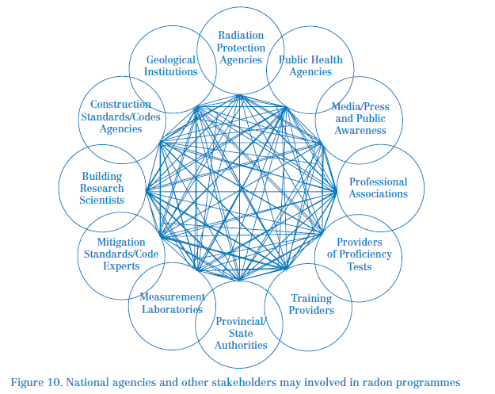
WHO Handbook on indoor radon 2009
“Collaboration, engagement”
Stakeholders involved in
radon control
the implementation of radon prevention and mitigation
Stakeholders including researchers, radon measurement providers, builders, and officials who are responsible for implementing regional and national health guidance“

Slide 11
ICRP 126
ICRP 126, 2014:
“Relevant stakeholders”; “all stakeholders”: individual householder; builder or seller of a property / buyer; landlord / tenant; employers / employees, generally speaking, the responsible person for any building towards its users; the building users; the individual, general population; owner of a house; manager of a school; the local authority.
“The action plan … should identify stakeholders, such as those who are exposed and those who should provide support or implement action; ...”
(88) The radon protection strategy should include a programme of actions including provision of general information on radon behaviour and risk, campaigns aiming to increase awareness among the targeted public,
Section „2.4.2. Responsibilities of stakeholders“: interactive aspects

Slide 12
IAEA 2015 - 1
IAEA specific safety guide 2015 -1-
Provision of information on radon; requirement to provide public information;
3.17: “… the national authority should prepare information and make it available to all interested parties”: decision makers, medical practitioners, building professionals (including architects, engineers, quantity surveyors and builders) and the public.
“When setting a reference level, the national authority should consult interested parties”
„The level of awareness may be evaluated …“

Slide 13
IAEA 2015 - 2
IAEA specific safety guide 2015 -2-
„The national authority should ensure cooperation with the authorities responsible for the regulation of the planning and construction of buildings…”.
This includes those authorities responsible for addressing other aspects of indoor air quality and energy efficiency. Site inspection forms an important part of building regulation.
Communication with and training of both building inspectors and professionals in the construction industry“
“…the national authority should develop strategies to inform the public about the risks due to radon and about preventive measures and corrective actions. …also target bodies and professional groups concerned with housing and with public health, such as builders, architects and regional and local government authorities and the medical profession”

Slide 14
EU BSS 2013
Article 74 Indoor exposure to radon, “3. Member States shall ensure that local and national information is made available on indoor radon exposure and the associated health risks, on the importance of performing radon measurements and on the technical means available for reducing existing radon concentrations”.
ANNEX XVIII / (10) “Strategy for communication to increase public awareness and inform local decision makers, employers and employees of the risks of radon, including in relation to smoking”.
Article 102 Implementation of strategies: “Member States shall … ensure appropriate coordination between relevant parties involved in the implementation of remedial and protective measures. Member States shall provide as appropriate for the involvement of stakeholders in decisions regarding the development and implementation of strategies for managing exposure situations”.
No target groups or potential recipients of that information are mentioned.

Slide 15
Complementary: Interviews
Interviews with: 3 representatives of international organizations (ERA, ICRP, IAEA); 1 representative of a national organization
→ stakeholder engagement in the field of indoor radon mostly builds upon an instrumental rationale; engaging stakeholders is primarily a tool for radon measurements and mitigation strategies, and thus for tackling the issue of radon exposure.
→ two main forms of stakeholder engagement:
awareness raising / information provision on the issue of radon (a perceived prerequisite to taking action),
co-developing and implementing new regulations → higher level of participation, as this comprises discussion and decision-making, involving mostly institutional actors

Slide 16
Summary international prescriptions
Level of Stakeholder engagement:
mostly information.
But, stakeholder involvement of special importance in WHO Handbook (2009!) and ICRP 126.
Instrumental motivations
public awareness should be raised by information.

Slide 17
National documents
Slovenia
Ionising radiation protection and nuclear safety act (ZVISJV-1), Off. Gaz. 76/2017 – Atomic Act.
National radon action plan adopted in 2018
Germany
Radiation Protection Act, adopted on 12 May 2017
National radon action plan 2019
Belgium:
Belgian national radon action plan, 2017-03-29-BDE-7-4-1-EN; date: 2017-03-29”
“RADON: Plan de communication; CFA/1 mars 2012” and presentation “Approach and evaluation of the radon communication plan in Belgium”
Publicly available materials from FANC-AFCN (Federal Agency for Nuclear Control from Belgium): presentations at conferences, scientific articles, dedicated radon internet pages

Slide 18
Main findings national documents
Stakeholder engagement is not an issue (Germany, Slovenia), no definition of stakeholder; however, relevant groups that are part of the mitigation processes are mentioned (Belgium)
Germany:
National radon action plan : radon information is a relevant part;
Important activities on the subnational level (Länder)
Slovenia: information and engagement part of the radon action plan
Communication, information of high importance in Belgium, as well as awareness campaigns. Objective:
to increase the public awareness; to convince the stakeholders of the benefit of taking action; to inform the stakeholders; increase the knowledge; guide the stakeholders to the right information; bring about changes in the behaviour of the stakeholders.

Slide 19
ERPW, Rovinj: Round Table on Stakeholder engagement
Abelshausen, B., et al., Round table on stakeholder engagement in relation to radon exposures, in 3rd European Radiation Protection Week October 2nd, 2018. 2018, H2020 CONCERT-ENGAGE: Brussels.

Slide 20
WP2, Stakeholder Engagement in Practice: 4 Case studies
“Stakeholder engagement in case of the national radon program” (Slovenia)
“Communication and Management of intervention in case of high radon exposure level” (Wallonia – Belgium)
“Stakeholders in radon risk and prevention in Italy”
“Evaluating radon websites from a stakeholder engagement perspective”

Slide 21
Case study Slovenia: Stakeholder engagement in case of the national radon program
What: to analyse the practices of stakeholder engagement related to requirements from the national decree.
How:
Analysis of legal framework,
Document and website analysis
Interviews with responsible staff (“how were information interpreted?)
Findings
The responsible authorities are lacking the resources, especially human one to effectively perform control and provide the advices.
Awareness of the public, and also small municipalities, about the risk posed by radon: relatively low; advices from the authorities are not followed; interest in radon measurements is high especially in public buildings.
Radon topic: responsibility of several ministries, but no coordinated approach.

Slide 22
Case study Wallonia – Belgium: Communication and Management of intervention in case of high radon exposure level
What:
To highlight the dynamics of local actors when a sensitive public infrastructure, a primary public school, is exposed to radon.
To analyse the interactions and communication patterns between professional experts and with the local authority and local inhabitants.
How:
Analysis of an local event of radon exposure in a primary school; interviews, document analysis
Findings: plurality of sensemaking
Plural Authority Management: power, responsibilities, communication
Low level of awareness, disparity of knowledge
Lack of knowledge and engagement in professionals
Pro and cons of mapping risk zones

Slide 23
Case study Italy: Stakeholders in radon risk and prevention
What:
to analyze which stakeholders are involved in an active way in radon risk information and prevention
Which levels of involvement, exchanges of views and experiences
How:
document analysis, interviews
Findings:
Importance of local institutional partners in processes of collaboration
Sporadic awareness, unpredictable
Importance of E&T of young people
Competing health issues limit attention on radon

Slide 24
Case study: Evaluating radon websites from a stakeholder engagement perspective

availability of radon information
limited
What:
Website evaluation
How:
indicators related to:
Findings: Room for improvement on websites regarding
consistent information supported by engaging stories,
provide for personalized features,
allow for stakeholder feedback and dialogue,
include the use of social media

accessibility
challenging

stakeholder interaction
Not radon-specific

dialogue
poor

responsiveness
insufficient

content and design
Content: dispersed

transparency
limited

openness
limited

Slide 25
Findings: Connection prescriptions-practice
None of the analysed documents on the national level gives a specific definition to stakeholders.
Prescriptions and recommendations: stakeholder engagement as a means to tackle the issue of health impact of radon exposure
Other values underlying stakeholder engagement not made explicit
e.g. an improved decision process
If stakeholder engagement is only used as a tool with stakeholders as mere resources: it may jeopardize effective and sustainable engagement processes from the different groups of stakeholders
Recommendation: Make explicit also the other values – not only the instrumental rationale – for stakeholder engagement

Slide 26
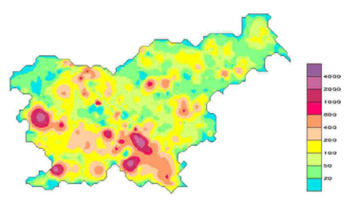
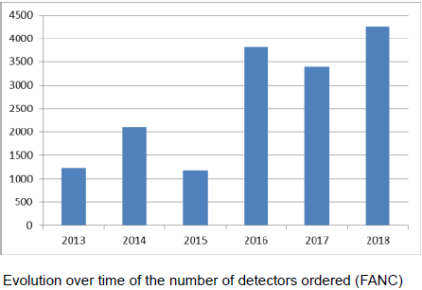
Findings: Connection prescriptions-practice
Responsible authorities may lack resources, especially human resources, and appropriate organisation with involvement of all levels of public authorities to effectively perform control and provide remediation advice
➔ (see for instance Slovenian case study).
Stakeholder engagement often shaped as awareness-raising actions
Low awareness among population at large, and professionals.
Disparities of knowledge: higher awareness in very high risk areas.
Divergence between participation for radon measurement (increasing) and % homes asking support for remediation (low).
Several Member States do not include in the plan a structured evaluation, with stakeholder involvement
➔ (see Belgian case study).
Recommendation: Define within the radon action plan the approach for its evaluation and carry out the evaluation together with regional and local authorities
Notes:
In Slovenia: The interest in radon measurements is high especially in public buildings. The available funds are limited. They are used by the principle the first who request is the first in line. When the money is used up, the requests are addressed in the next year.
The blue column graph shows that the number of detectors required from the national radiation safety authorities is on the rise

Slide 27
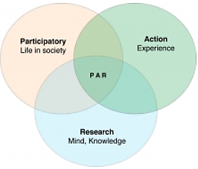
Findings: Connection prescriptions-practice
Only a small fraction of the population carries out measurements or applies remediating measures.
Action oriented research (e.g. citizen science) opens opportunities for engaging local stakeholders in radon measurement and mitigation.
…engaged in different policy issues and / or at different levels of responsibility
Picture: https://uwaterloo.ca/renison/van-katwyk-journal-progressive-human-services-article
Further research: Develop action research oriented towards improving radon measurement and mitigation at local level with stakeholder engagement

Slide 28
Case studies related to RP culture in the field of radon management (ENGAGE WP3)
France: Actions developed at local level within the “Franche-Comté Radon pluralist project” for the development of radiation protection culture for different categories of stakeholders
Greece: Development of radiation protection culture for different categories of stakeholders at local level by the national authority (EEAE)
Switzerland: Actions undertaken in the framework of the implementation of the radon national action plan by the national authority (FOPH) in collaboration with the Society of Engineers and Architects and universities of applied sciences and building professional schools

Slide 29
Target Stakeholders – Aim of RP culture
Wide range of target stakeholders for the dissemination of RP culture related to radon exposures in dwellings and public buildings
Inhabitants living in radon areas
Building professionals (organizations, groups and workers in the field of building construction and maintenance)
Local/national authorities
Local elected representatives
Local communities
Aim of RP culture:
Common aspect for all stakeholders:
to raise awareness about the health risk associated with radon exposure
Health risk to be expressed with reference to the risk of lung cancer in a general way, without considering a specific individual risk assessment.
Specificities related to the role of these stakeholders

Slide 30
Aim of RP culture: Specificities related to the stakeholders (1/2)
For inhabitants living in radon areas
To raise their awareness about potentiality of radon exposure in their home
To acquire knowledge on ways to measure exposures and to remediate to the situation
To increase their willingness to implement measurement in their home and remediation / protection actions
For Building professionals:
To raise their awareness about radon risk in buildings (dwellings, public buildings,..),
To acquire knowledge on the possible remediation actions
To integrate radon risk at the design stage of new buildings (preventive actions),
To integrate the radon issue in a global approach of public health in buildings
To be able to evaluate the efficiency of the actions implemented.

Slide 31
Aim of RP culture: Specificities related to the stakeholders (2/2)
For local elected representatives / local communities (mayors, group of municipalities …)
To raise their awareness about radon risk in their local area
To acquire knowledge on their responsibilities regarding this risk
To implement measurement campaigns in their municipalities
To implement or support remediation / protective actions
National / local authorities (in charge of RP, Health, Environment, Air Quality …)
To raise their awareness about radon risk
To be involved in the elaboration / implementation of actions such as measurement campaigns, remediation / preventive actions

Slide 32
Tools, methods and process to build RP culture (1/2)
Multiple tools and processes: leaflets, training sessions, dedicated meetings … to be adapted to the needs and integrated into radon action plans (at the local or national levels).
Importance of involving multidisciplinary teams with representatives of target stakeholders in the elaboration of the tools and communication media and involving experts (RP experts, experts from the target stakeholders groups (eg. Involvement of Scientific and Technical Center, Building professional Associations, …)
Some specificities regarded to Target Stakeholders
General Public: information, communication, involvement
Create meeting opportunities between population, experts, authorities, local elected representatives, to discuss and share the information initially provided in leaflets
Meetings after measurement campaigns to explain the results of measurements and provide advice for remediation / prevention
Ensuring relays at the local level for the dissemination of the technical information towards the population (identification at local or regional level of “radon consultants”)
Give access to complementary information – e.g. Websites

Slide 33
Tools, methods and process to build RP culture (2/2)
Some specificities regarded to Target Stakeholders
Building professionals: training, practice, networking
Identify the various types of building professions that can potentially been involved in diagnostic, remediation or prevention actions. It includes notably craftsmen form various fields, engineers, architects ….
Initial training: integration of radon issues in the professional schools is the basis to initiate awareness and to ensure and integration of these issues in the long term
Continuous education: to regularly update the knowledge and techniques integrating feedback experience and new developments
Enhancing professional competences: creation of a “radon label” or certification recognised at a national level
Role of building professional associations, or unions: seminars or congresses of the professions, integration of radon issues in the initial training programmes related to their professions, creating network of professionals that can exchange about their practice and collect feed-back experience

Slide 34
Lessons learned – Key issues in developing RP culture in the field of radon exposure
Radon is a complex issue (radiological protection, geological, construction, behavioural, indoor air quality) … It is thus important:
to develop a multidisciplinary approach in the elaboration of RP culture dissemination actions,
to share knowledge and expertise from each type of stakeholders to be involved
to adapt the messages and actions to the target stakeholders
The dissemination of a RP culture in the field of radon starts with raising radon risk awareness, to have it considered as a health issue, together with providing the elements on protective/remediation measures.
Processes to build RP culture can be initiated by national or territorial (local) actors. Each has a specific role and they should work close together. There is however a need for a regulatory framework to support the processes
It is essential to consider the processes to disseminate RP culture on radon on a long-term perspective. Actions have to be renewed regularly to maintain dynamic toward the radon action plans

Slide 35
Summary
For radon exposures, there are large differences in how the role and level of stakeholder engagement are interpreted
On the formal, international level
On the formal level in different countries
On the practical, national level in different countries
On different regulatory and policy levels within different countries
However, stakeholder engagement is important
To improve dealing with radon
To strengthen RP culture

