Slide 1
Further Researches in view of ENGAGE Project results
ENGAGE final workshop, Bratislava, 11-13 September 2019

Slide 2
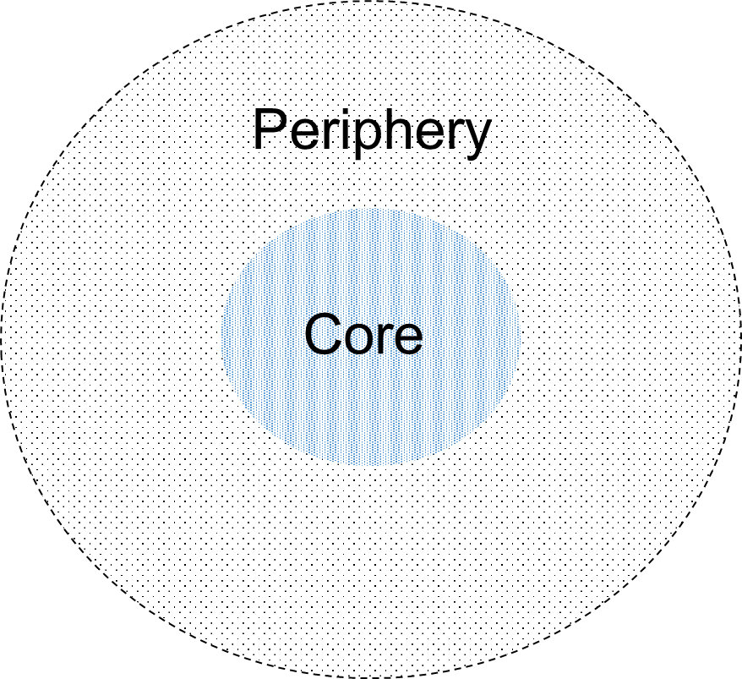
Broadening the scope of ‘participation’ in radiation protection (beyond formal institutional approaches, new actors) EP&R
In EP&R it is not always clear who is “in” or “out” of stakeholder engagement (e.g. future generations can and should be involved as a stakeholder or their role is mainly for keeping ‘memories alive’?, what to do with ‘non-participants’, non-human stakeholders (for example animal or, plants)).
The case study on participation outliers (cfr purposeful mapping) also shows the importance of stakeholders that do not want to participate: ‘how should EP&R deal with dis-engagement?
Further developments EP&R 1: Explore which stakeholders are” in” or “out” of stakeholder engagement and why not

Slide 3
RP Culture EP&R
While preparedness strategies to cope with emergency and post-accident situations are currently developed or under-development at the international and national levels, the specific role of RP culture requires further developments.
The elaboration of a strategic document would provide the opportunity to better characterise the conditions and means for developing RP culture in this context
Identification of stakeholders - roles and responsibilities – goals & tools for RP culture dissemination – Evaluation processes - …
Further developments EP&R 2: Elaborate a strategic document to be used by authorities and expert bodies to build a roadmap for the development of RP culture during the preparedness phase

Slide 4
RP Culture EP&R
Citizen science activities enabling members of the public to perform their own measurement of radioactivity in the environment have proven to be a key tool to develop RP culture among populations affected by a nuclear accident.
These types of activities should also be developed among populations not affected by nuclear accident, as a tool to develop practical RP culture.
Build framework for citizen science projects
Develop collaborative structures
Further developments EP&R 3: Development of citizen science projects to disseminate RP culture

Slide 5
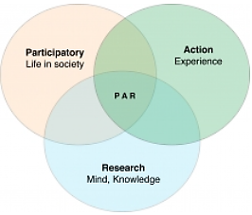
Connection prescriptions-practice Radon
Only a small fraction of the population carries out measurements or applies remediating measures.
Action oriented research (e.g. citizen science) opens opportunities for engaging local stakeholders in radon measurement and mitigation.
Action research with case studies highlighting the interactions between stakeholders engaged in different policy issues and / or at different levels of responsibility
Picture: https://uwaterloo.ca/renison/van-katwyk-journal-progressive-human-services-article
Further developments Radon 1: Develop action research oriented towards improving radon measurement and mitigation at local level with stakeholder engagement

Slide 6
RP culture - Radon
Building professionals have a key role to play in the implementation of radon remediation actions.
Radon risk should also be considered when renovating existing buildings and at the design stage of new buildings (preventive actions).
The aim is to integrate the radon issue in a global approach of public health in buildings (in connection with indoor air quality, energy efficiency, …).
According to the variety of professionals, it is beneficial to develop training supports (for initial and continuous educations) adapted to their specialty, by involving representatives of these professions.
Further developments Radon 2: Elaboration of training materials for, and together with, building professionals

Slide 7
RP culture - Radon
It is still difficult to evaluate the efficiency of actions undertaken to raise radon risk awareness, implement radon measurement campaigns and radon remediation actions.
In particular, need to understand:
why there is a poor rate of measurements in dwellings despite the implementation of local measurement campaigns, and
why remediation actions are not implemented by house owners while there is a high radon concentration in their house (e.g. cost issue, availability of experts).
How to promote actions integrating radon, indoor air quality and energy efficiency?
Further developments Radon 3: Development of tools and methods to evaluate the efficiency of radon RP culture dissemination actions

Slide 8
RP culture - Medical
Initial training for health professionals who are not directly involved in medical procedure using ionizing radiation might be of short duration.
It is thus important to provide them with the possibility to have access to further information, adapted to their profession.
The access to this type of information is also necessary to improve the day -to-day practices by providing a regular update of skills and knowledge on RP culture.
Further Developments Medical 1: Develop open access sources of information on RP in the medical field to complete initial training of the health professionals who are not directly involved in medical procedures using ionizing radiations but may be occupationally exposed and/or interacting with patients

Slide 9
RP culture - Medical
Need to be able to periodically evaluate the level of RP culture shared within the medical departments in order to better adapt the actions undertaken to improve the practices from RP point of view.
To this end, it would be useful to develop, methods, tools or indicators, to be shared not only at the local level (of a specific hospital), but also more generally at a national or European level, within different medical professions or authorities.
Elaboration of frameworks for internal evaluation of RP Culture at the level of a medical department or hospital
Elaboration of frameworks for external evaluations, to be performed for example by Authorities, external experts or professional associations
Further Developments Medical 2: Develop methods and tools to evaluate the level of RP culture in the medical departments using ionizing radiations in their practices

Slide 10
Other ideas put forward in this workshop
Risk communication to patients – capture patients’ view on how they would like to be informed
What constitutes “quality information”?
Respect emotions, feelings, sensitivities, religious, cultural aspects
Patients representatives: where to find them, how representative are they, how to involve them?
Social media influence - dealing with disinformation on social media in case of an emergency
Media and citizens groups a partners
Goal of participation of local communities in risk management in the preparedness phase
Roles played by nuclear actors with respect to risk assessment and risk management in EPR and what the influence is on other stakeholders such as the public
Integration of new technology in EPR
Evaluation of stakeholder engagement processes and the uptake of their outcomes at national levels
Application of ethical considerations for EPR actions such as evacuation of hospitals: how do to more good than harm if the benefits and harms are distributed to different people → these discussions have to be held in the preparedness phase
Using machine learning or chatbots to communicate about radon
What are the processes to transform recommendations into actual policy?

