Slide 1
ENhancinG stAkeholder participation in the GovernancE of radiological risks for improved radiation protection and informed decision-making
Catrinel Turcanu
Institute for Environment, Health and Safety, SCK•CEN
cturcanu@sckcen.be
ENGAGE final project meeting, Bratislava, 11-13 September 2019

Slide 2
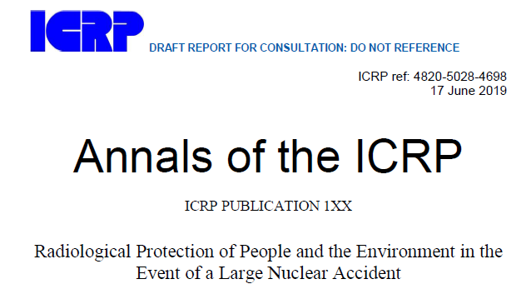
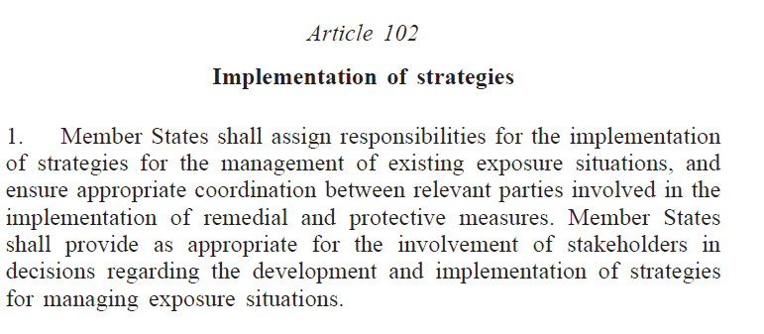
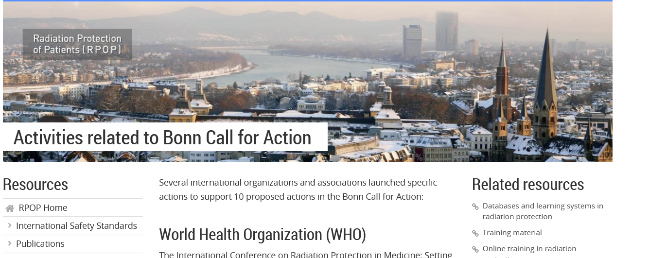
Notes:
Stakeholder involvement is a keyword in the latest ICRP publication on protection in case of large nuclear accident

Slide 3
Project entry points
Stakeholder engagement and informed decision-making are increasingly recognized as essential in the governance of radiological risks.
However, the practical implementation of policy and legal requirements for stakeholder engagement is confronted with multiple challenges.
We must therefore better understand why, when and how stakeholders engage in radiation protection.
This understanding will facilitate the development of guidelines and recommendations for a more robust stakeholder engagement in radiation protection.

Slide 4
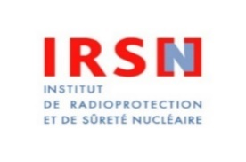
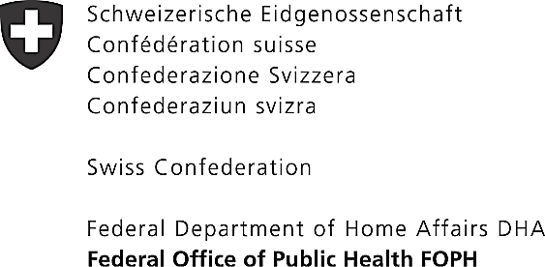
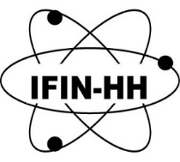
ENGAGE
ENhancinG stAkeholder participation in the GovernancE of radiological risks for improved radiation protection and informed decision-making
November 2017 - November 2019
Total cost: EUR 777,442.00. Funded by EU: EUR 475,640.00

Slide 5
Who engages? Who doesn’t?
What is engagement for?
Who benefits and why?
What is the impact?
What role for Radiation Protection Culture?
…

Slide 6
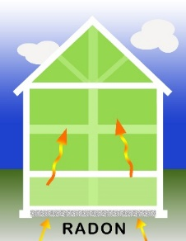
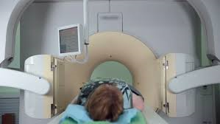
Focus on stakeholder engagement in practice
What is the role of Radiation Protection Culture?
WP1: Rationales and frameworks for stakeholder engagement
WP3: Development of radiation protection culture to support the governance of radiological risks
What are the prescriptions and expectations for stakeholder engagement?
Which forms of participation can be observed in practice?
WP2: Stakeholder engagement in practice
WP5: Coordination
Stakeholder advisory board
MEDICAL EXPOSURE
EMERGENCY & RECOVERY
PREP. &RESPONSE
INDOOR RADON
How can we share experiences and enhance learning?
WP4: Competence building and dissemination

Slide 7
Three exposure contexts considered
Justification of exposure
Risk / benefits of exposure
Recognition of stakeholder engagement
Stakeholders concerned by the situation
Objectives of stakeholder engagement processes
Characteristics influencing perception of risk: voluntariness, personal control, natural vs. artificial, perceived fairness of risk distribution, …
Exposure characteristics
Influence of different actors on radiation protection
EMERGENCY & RECOVERY
PREP. &RESPONSE
MEDICAL EXPOSURE
Compare and contrast
INDOOR RADON
Notes:
International and EU level ideas gain traction and become entrenched as science policy. They are circulated among knowledge elites and policy professionals, who then disseminate the concepts to member states, creating convergence around particular models/regimes (e.g. RRI). These concepts are enacted (performed, resisted, altered) in/through projects and practices, which may in turn inform radiation protection policies. The EU and MS levels are macro; projects and practices are meso-micro. But each level incorporates macro, meso, and micro dimensions.
Macro level: focus is on policy prescription, unit of analysis is discourse.
Meso-micro levels: focus is on enactment/practice, unit of analysis can be discursive (e.g. interpretive repertoires, issue frames), material (e.g. tools and objects), organizational, etc.

Slide 8
Levels of analysis
Notes:
International and EU level ideas gain traction and become entrenched as science policy. They are circulated among knowledge elites and policy professionals, who then disseminate the concepts to member states, creating convergence around particular models/regimes (e.g. RRI). These concepts are enacted (performed, resisted, altered) in/through projects and practices, which may in turn inform radiation protection policies. The EU and MS levels are macro; projects and practices are meso-micro. But each level incorporates macro, meso, and micro dimensions.
Macro level: focus is on policy prescription, unit of analysis is discourse.
Meso-micro levels: focus is on enactment/practice, unit of analysis can be discursive (e.g. interpretive repertoires, issue frames), material (e.g. tools and objects), organizational, etc.

Slide 9
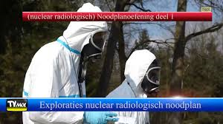
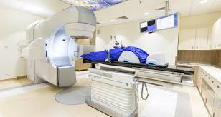
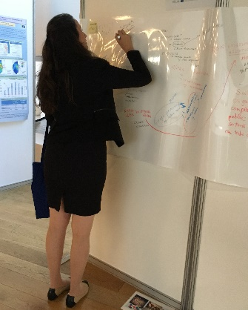
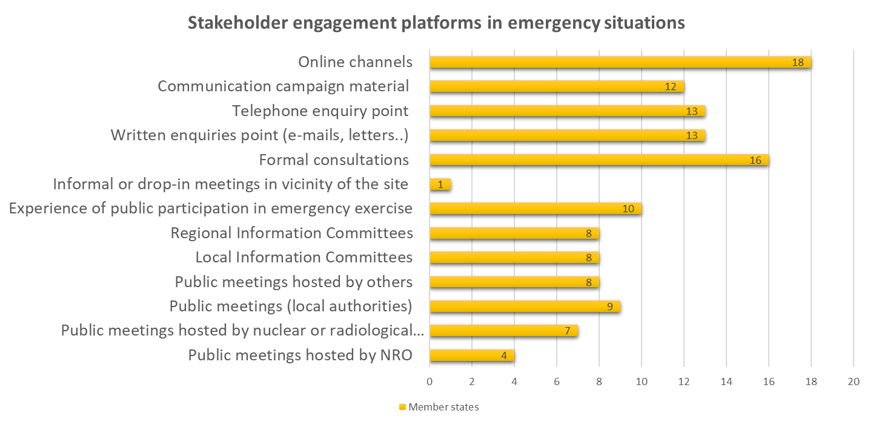
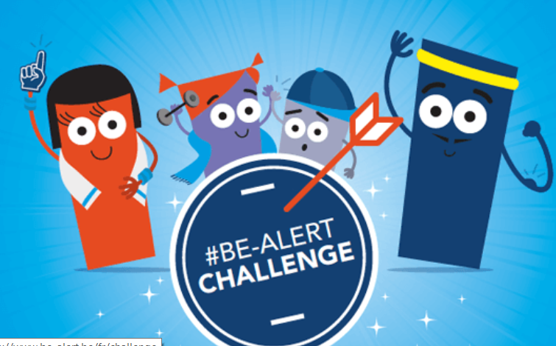
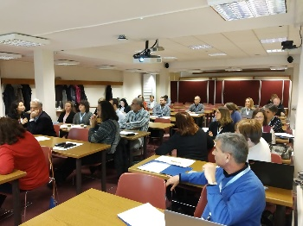
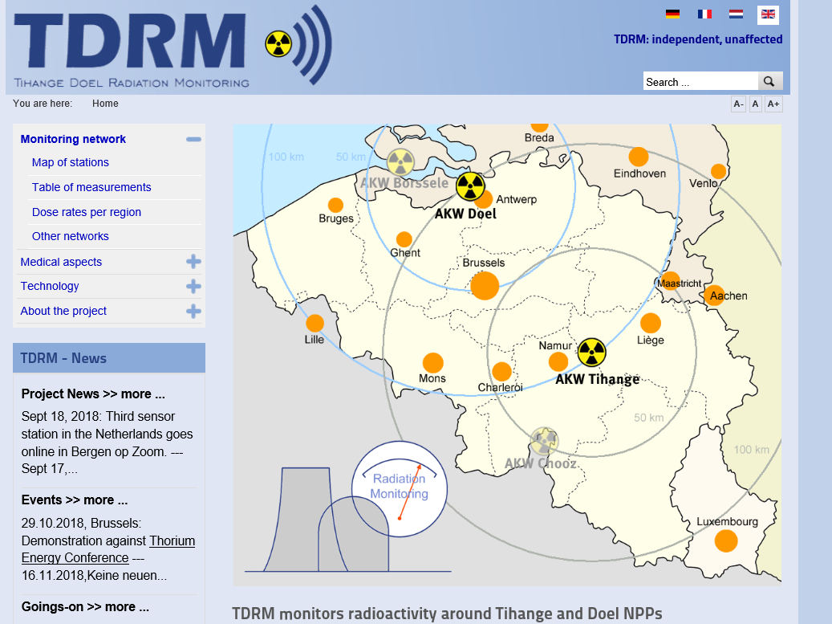
Multi-method approach
National case studies
Cross-national analysis
Participation practices & RP culture
Radon websites in 8 EU Member States
3 exposure contexts
Mapping formal and informal participation
(EP&R in BE)
Round tables, experiments, workshops, interviews ….
Survey in EU countries (EP&R)

Slide 10
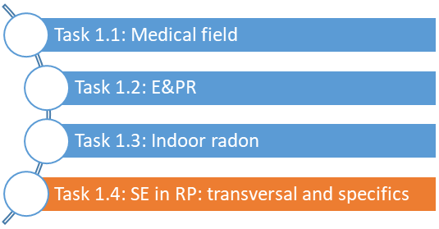
WP 1 Rationales and frameworks for stakeholder engagement in radiation protection
Object of analysis: Macro discourses that justify and/or prescribe stakeholder participation in radiation protection
Methods:
Document analysis
Legal requirements & guidelines on RP or environmental matters
EURATOM BSS and other directives
Conventions (Aarhus, ESPOO,…)
Guidelines from ICRP, IAEA, OECD, HERCA, WHO,…
Specific requirements and guidelines per field (national and international)
Semi-structured interviews
Key actors per field, e.g. RP policy makers, civil society organisations
Notes:
On-going
EU policy legislation, policy briefs, presentations,
EC directives(e.g. BSS) and conventions (Aarhus, ESPOO,…)
Guidelines from international organisations (e.g. IAEA, OECD-NEA, HERCA, ICRP, ENSREG,…)
National level legislation or frameworks
Statements or documents from radiation protection platforms
Civil Society statements or reports
sensitizing concepts; that is, as constructs that sensitize us to possible lines of inquiry, and which can be adapted to the case at hand and the developments that ensue during fieldwork (van den Hoonard, 1997).
Keywords: stakeholder, interested /concerned parties, public, involve*, engage*, participation

Slide 11
WP1 Rationales and frameworks for stakeholder engagement in RP- Methodological approach
Analysis based on a list of guiding questions and sensitizing concepts, e.g.
Which actors (and which networks) are being called/expected to engage or participate in RP, by whom, when, why and how?
How do the actors define “stakeholder” and how do they understand engagement? What are their expectations from such processes?
Can we identify aspirations or trends towards more or less stakeholder participation?
What potential implications do these conceptions entail for RP institutes, communities, platforms, and researchers?

Slide 12
WP2 Stakeholder engagement in practice
Objectives:
Analyse how legal requirements, guidelines and recommendations for stakeholder engagement are implemented in practice
Reveal which (other) real or potential forms and instruments of stakeholder engagement and public participation can be observed in RP practice, showing no reference to existing requirements
Outcomes, related to three exposure situations
What is the impact of past or on-going participatory practices (or of their absence) ?
Are stakeholder engagement approaches comparable?
Which broader lessons can be learned, what is specific to each field and why?
Methodology: Case studies, but also purposeful mapping, website analysis, surveys

Slide 13
WP2 Stakeholder engagement in practice: guiding questions
Analysis based on a list of guiding questions and sensitizing concepts, e.g.
How do researchers and practitioners understand and practice stakeholder engagement (at individual and institutional level)?
What were the rationales for stakeholder engagement, the final objectives?
What was the impact of stakeholder engagement?
Are there any alignments/misalignments between case practice, on the one hand, and external conceptions and prescriptions, on the other, and if so why?
Which challenges and opportunities do we encounter for stakeholder engagement in specific cases?

Slide 14
WP3 Development of radiation protection culture to support the governance of radiological risk
Objectives
To investigate the role and potential benefit of building and enhancing radiation protection culture for supporting effective stakeholder engagement and informed decision-making in relation to radiation protection at individual and collective level;
To identify processes to build and transmit radiation protection culture, adapted to the specificities of different exposure situations; and
To elaborate guidelines/recommendations for building RP culture in view of supporting stakeholder engagement in the governance of radiological risk.
Methodology
Common analysis grid
Description of case studies based on the practical experience of the partners, involved in the actions presented

Slide 15
WP3 – Analysis Grid -1
Characterisation of case study including type of actions, processes, e.g.
E.g. Context, ‘target’ stakeholders, aims of RP culture, stakeholders initiating the implementation of the actions / processes, evolution of the actions with time
Characterization of RP culture (elements / definition)
E.g. Individual or collective knowledge, knowledge sharing, type of knowledge (e.g. radiation effects, risks, actions to manage radiation risk situations, radiation hygiene), role of historical-societal culture and individual behaviour, specificities of RP culture
Development of tools, methods & processes to build, enhance and transmit RP culture
E.g. RP culture dissemination process, efficiency of processes and influence on practices, understandings, behaviours of the target stakeholders regarding RP; role of experts; sustainability; addressing scientific uncertainties; inclusiveness

Slide 16
WP3 – Analysis Grid -2
Evaluation of the level of RP culture
E.g. methods and tools to evaluated RP culture; capability of target stakeholders to interact with RP professionals (or other actors); willingness and capability to be involved in RP decision making, to share common knowledge.
Highlighting the role of RP culture
E.g. contribution of RP culture to the improvement of the situation for which the dissemination process has been implemented (decision-making process, stakeholder engagement process, radiation risk management situation, health and well-being of the population, …); impact of developing / building RP culture? (impacts on the level of exposures, the protection actions, the decision making-processes,…); interaction between RP culture ad stakeholder engagement
Connection with the European RP research programme

Slide 17
WP4 Competence building and dissemination
Objective: To disseminate the results of the project to all stakeholders in the radiation protection field and enhance mutual learning
Reports and presentations: open access
Roundtables and other events at international venues
RICOMET special sessions
Workshop on radiation protection culture (Athens, 2019)
Final project workshop
Open access publication of main project results in Radioprotection
Synthesis report with recommendations for stakeholder engagement and radiation protection culture
Draft recommendations to be discussed during this workshop
Knowledge base on stakeholder engagement for the radiation protection community covering three exposure situations

Slide 18
This workshop
Presentations: summary of findings
Details on case studies for stakeholder engagement in practice and radiation protection culture: in posters
Discussions: findings and recommendations, particularly putting them into practice

