Slide 1
Stakeholder engagement - What is, can or should it (not) be?
Bieke Abelshausen, Catrinel Turcanu
babelsha@sckcen.be
ENGAGE final workshop, Bratislava, 11-13 September 2019

Slide 2
Content
Introduction in Stakeholder engagement
General theories and paradigms in stakeholder participation
Complexity within the ENGAGE project
Pragmatic decisions made within the ENGAGE project
Themes
Conversation With Jackson Pollock No.41 is a painting by George Sanen which was uploaded on November 26th, 2015.

Slide 3
Stakeholder engagement - Stakeholders
Stakeholder: person, group or organisation with an interest (or stake) in the decision
directly affecting the decision or
being affected by it.
Organised according to various relationships
Homogeneity (groups-)
Relationship between groups
Relationship to frame or setting

Slide 4
Stakeholder engagement - Stakeholders
COMPLEXITY
No consensus
‘Who’ and ‘what’ – NO ‘ONE’ DEFINITION
Consensus versus dissensus
Power dependent
Dependent on who gives the argumentation
Context dependent
Situational
Cultural
Worldview

Slide 5
Stakeholder engagement - Stakeholders
Pragmatic consensus
ENGAGE defines stakeholders as:
actors: individuals or groups, institutional and non-institutional
with a tangible or intangible (yet to be shaped or discerned) interest in the radiation exposure situation and the related radiation protection issues,
directly affecting decisions,
or affected by the formulation and resolution of a problem or challenge.
This includes wider publics
Implies that the notion of stakeholder is not fixed, but changes over time.

Slide 6
Stakeholder engagement - Participation
Conceptualisation of ‘participation’ from the 1960’s
Time influenced by powerlessness of the “have-nots”
Arnstein’s “ladder of participation” (1969)
Redistribution of power is essential
Participation in the 1970’s
Political turmoil fe US: Anti Vietnam War movement
Confrontation politics by those outside
Participation in the 1980’s – 1990’s
Link with development and sustainability
Institutionalisation of participation
Participation in the 1990’s
EPA citizen involvement into environmental protection programmes
Move towards social participation, citizen participation and participatory
methods
Beginning of 21th century
Shift of focus from conceptualisations to methodologies

Slide 7
Stakeholder engagement - Participation
Motivations for participation
Instrumental
“better way to achieve a particular end”
Most dominant motivation
Example
“to enhance transparency and accountability”
“to increase effectiveness of planning”
Substantive
“it leads to better ends”
Example
“stakeholder engagement […] results in sustainable decisions”
Normative
“it is the right thing to do”
“from a human rights perspective […] the right to be involved in processes that may profoundly affect them”

Slide 8
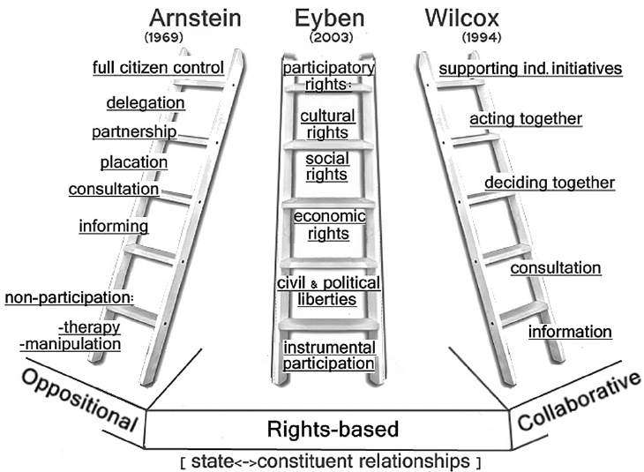
Stakeholder engagement - Participation

Slide 9
Stakeholder engagement - Participation
Low involvement
High involvement
Engage on complex issues
Inform or educate
Partner in implementation of solutions
Gather information
Discuss, dialogue
Communicate
Listen
Consult
Collaborate
Empower
Level of influence on decisions
Source: Health Canada Policy Toolkit for Public Involvement in Decision-Making. https://www.canada.ca/en/health-canada/corporate/about-health-canada/reports-publications/health-canada-policy-toolkit-public-involvement-decision-making.html

Slide 10
Stakeholder engagement - Participation
COMPLEXITY
Power dependent
Dependent on who gives the argumentation
Context dependent
Situational
Cultural
Worldview
No consensus
NO ‘ONE’ DEFINITION
Consensus versus dissensus

Slide 11
Stakeholder engagement - Participation
Pragmatism
Stakeholder involvement in decision making
What is it NOT?
Stakeholder participation ≠ communication
Redistribution of power
Combination of
Multi-directional knowledge sharing
Co-development/design
Co-decision making
Co-reflection
Stakeholder participation REQUIRES contextualisation
No “one-size-fits-all” solution
No “fit-for-purpose” solution

Slide 12
Stakeholder engagement
COMPLEXITY
Findings
Consensus versus dissensus Consensus AND dissensus
THEMES
Recommendations
Discussion at RICOMET
Should we give recommendations? Are they applied? By whom, how and why?
“Recommendations are not used so why should we make them?”
“Projects should have some kind of ‘impact’ and should therefore make recommendations”
“Recommendations are subjective and simplistic, they loose the complexity”

Slide 13
Stakeholder engagement
COMPLEXITY
Consensus versus dissensus Consensus AND dissensus
THEMES
Theme 0: ‘The connection between stakeholder engagement prescriptions and practice’
‘What is being asked’ and ‘what is actually being done’
COMPLEXITY
Prescriptions AND practice
Should we align?
Align prescriptions with practice?
Align practice with prescriptions?
Both?

Slide 14
Stakeholder engagement
COMPLEXITY
Consensus versus dissensus Consensus AND dissensus
THEMES
Theme 1: ‘The conditions for meaningful participation and commitment of institutional and non-institutional stakeholders’
Motivations for stakeholder engagement
COMPLEXITY
What is the influence of the motivations on the content and form of engagement?
Is this influence important?
‘Is one motivation better than an other?’
‘Should all types of motivations be included?’

Slide 15
Stakeholder engagement
COMPLEXITY
Consensus versus dissensus Consensus AND dissensus
THEMES
Theme 2: ‘Broadening the scope of ‘participation’ in radiation protection beyond formal institutional approaches’
Regarding ‘stakeholders’ AND ‘participation’
Formal and informal participation
COMPLEXITY
Prescriptions AND practice
‘Who SHOULD be involved?’
‘What type of participation could be?’
Who SHOULD be involved? in what manner? when?

Slide 16
Stakeholder engagement
COMPLEXITY
Consensus versus dissensus Consensus AND dissensus
THEMES
Theme 3: ‘Alignment of different decision levels: local, regional, national and international’
‘How can all stakeholder at different levels of governance be engaged?’
COMPLEXITY
Should all levels be engaged at all times?
Prescriptions versus practice

Slide 17
Stakeholder engagement
COMPLEXITY
Consensus versus dissensus Consensus AND dissensus
THEMES
Theme 4: ‘Bridging risk assessment, risk management and risk communication approaches and stakeholders’
“Bridging stakeholders and notions of participation from the different risk fields to create a more holistic approach”
COMPLEXITY
In which fields?

Slide 18
Stakeholder engagement
COMPLEXITY
Consensus versus dissensus Consensus AND dissensus
THEMES
Theme 5: ‘Informed decision-making (role of communication, access to information, informed consent)’
‘How can stakeholders make informed decisions?’
COMPLEXITY
What is ‘informed’?
What level of ‘informed’ is needed for decision making?
Complexity of common language

Slide 19
Stakeholder engagement
COMPLEXITY
Consensus versus dissensus Consensus AND dissensus
THEMES
Theme 6: ‘Radiation protection cultures, including objectives, target stakeholders, content, tools, evaluation processes & Education, training and capacity building’
‘What is, can and should be radiation protection culture, and education and training in all three fields?
COMPLEXITY
Stakeholders AND participation
How to develop RP culture?
How to integrate in existing practices?
Who should be involved?
Strategies?

